Slide 1

Pairs Trading of VISA and MasterCard
Dhyey Mavani (ddm2149)
Visiting Student at Columbia University, Spring 2023
(Sophomore triple majoring in Math, CS and Stats @ Amherst College)

Slide 2
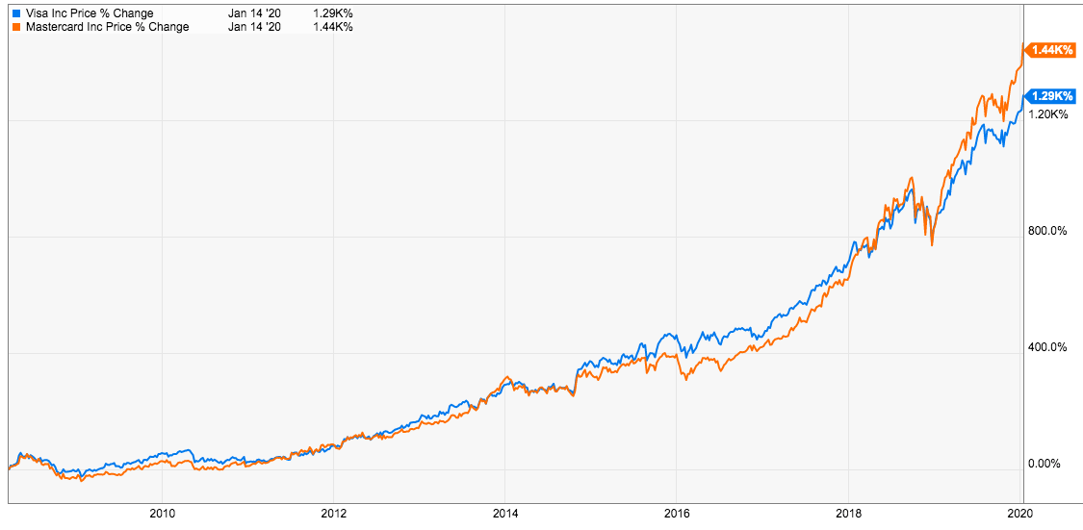
Why VISA and MasterCard?
Visa and Mastercard are the two largest payment processing networks in the world.
Visa and Mastercard do not issue cards directly to the public, as Discover and American Express do, but rather through member financial institutions.

Slide 3
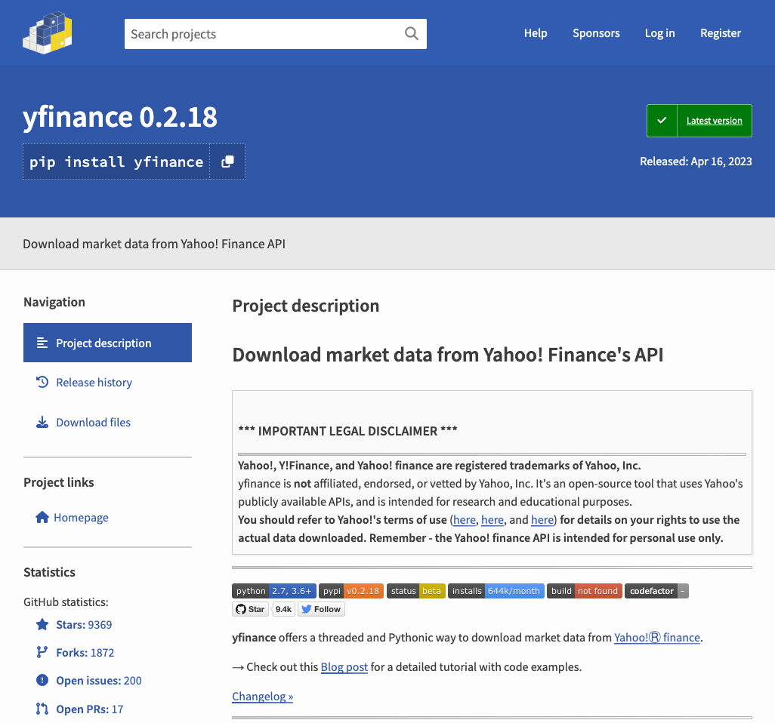
Data

Slide 4
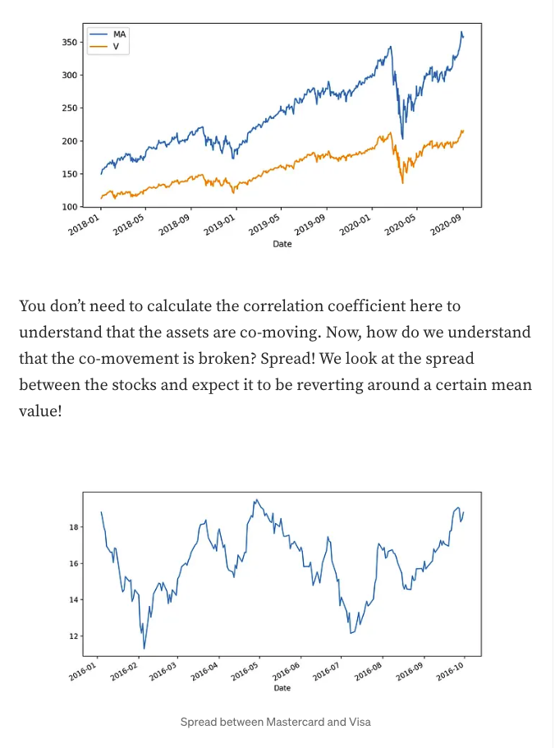
Pairs Trading
Reference: Medium Article
https://medium.com/@mikayil.majidov/pairs-trading-python-template-strategy-review-e22e8def539

Slide 5
Methodologies Explored
Just Buy and Hold Baseline without Pairs Trading
Buying the Loser
Logistic Regression
Decision Trees
Further Work
Please note that there are many more methods that can be used! I was just unable to explore a lot because of the time-constraints.

Slide 6
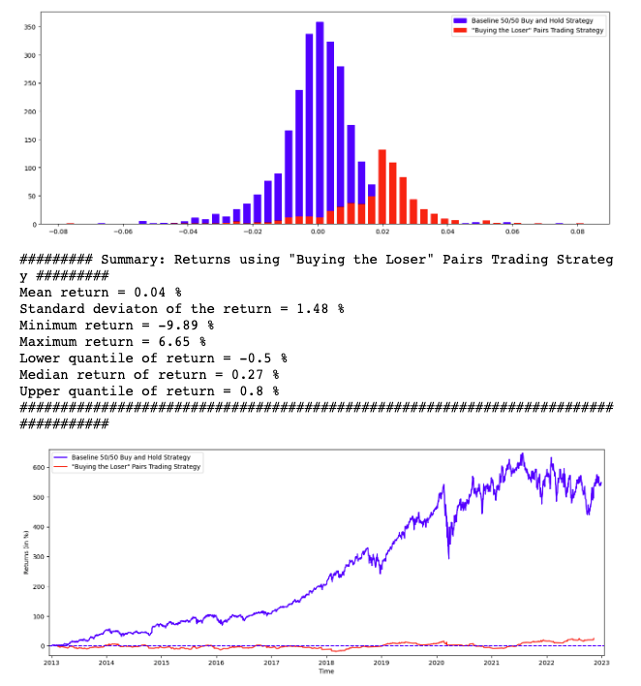
“Buying the Loser” Strategy
Whenever the companies depart from their mutual equilibrium in terms of spread, they should catch up in the next period.
Company which is currently valued less than expected (according to z-score band of spread) should be valued more next day.
Simple “Buy low sell high” logic
If demand for credit cards increase, stocks of both companies go up.

Slide 7
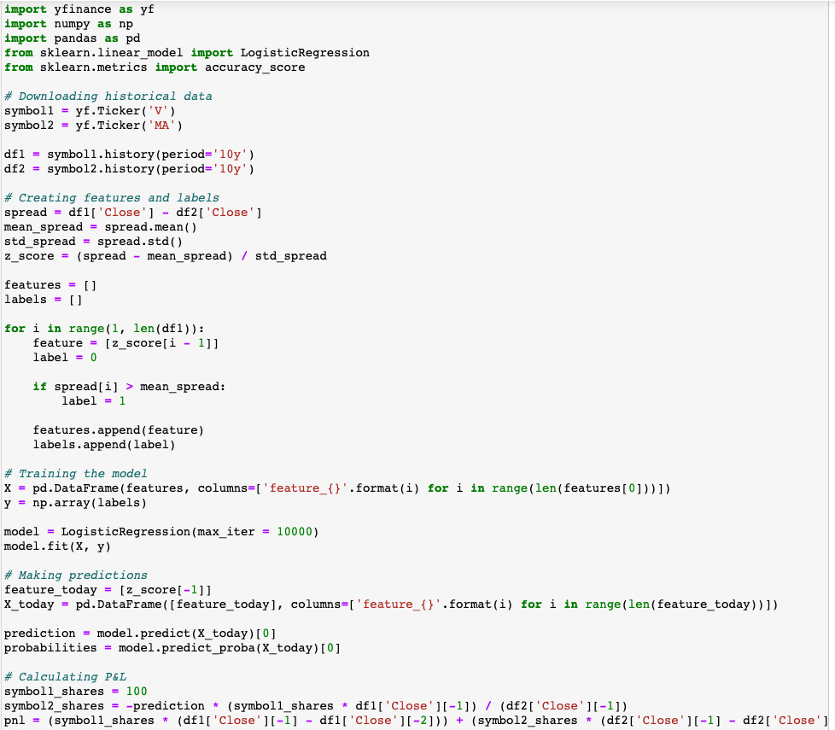
Logistic Regression Strategy
Calculate the spread and normalize using z-scores
Train a Logistic Regression model on if it increases or decreases in past if spread is greater than the mean spread.
Trade accordingly by by being Long on one and Short on the other.
Calculate the PnLs

Slide 8
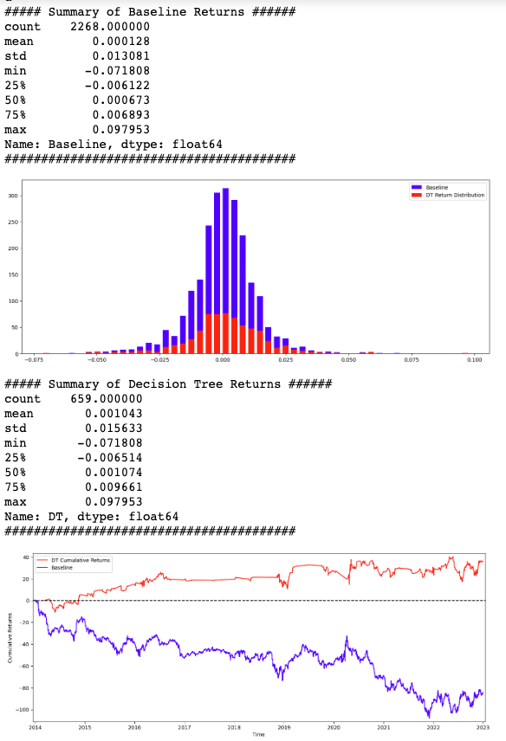
Decision Trees Strategy
Feature Engineering: Is_V (was V yesterday’s “loser”? ), ATR (Average True Range), V_Open and MA_Open.
10 x (0.75/0.25 yr training/testing) Decision Trees, maintain returns array.
Selected Hyperparameters at Random for now!
Plot the resulting returns distribution, cumulative returns and summary statistics.
Can be significantly improved if more effort into feature engineering using alternative datasets and creativity of quant researchers.

Slide 9
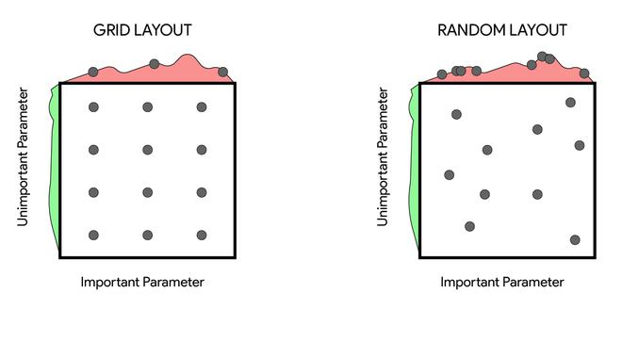
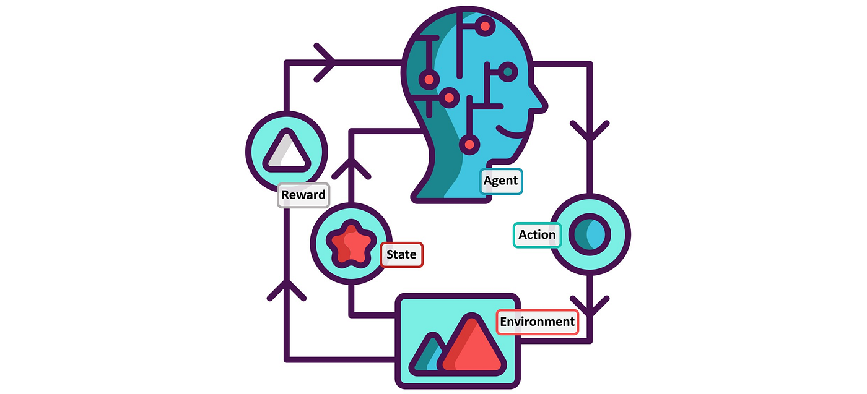
Further Work
Hyperparameter tuning can be done on Decision Trees.
Neural Networks
Reinforcement Learning
Ensemble methods
Tests like Cointegration
Using Kalman Filters
Reference: GeeksForGeeks and Towards Data Science

Slide 10
Final Thoughts
Some problems that we might face if we want to deploy this strategy…
Adverse Selection
Transactional Costs Accounting
Imperfect Execution of orders unless you are a designated market-maker

Slide 11

The End + [BONUS] Meme
Thank you so much for your attention to this presentation!
I look forward to exploring this topic further over the summer in my free time!
Here is a Bonus Meme just for fun! →
Reference: https://imgflip.com/i/1ezuu0

